Slide 1
Introduction to Planning
Dr. Shazzad Hosain
Department of EECS
North South Universtiy
shazzad@northsouth.edu

Slide 2
Planning as Search
Planning involves finding a plan which will enable a system (or a robot) to solve a problem, or carry out some task.
A planner aims to find a plan, which is a sequence of actions.
One method is to use search to identify a plan.
A search tree contains nodes which represent states, with edges between nodes representing actions.
‹#›

Slide 3
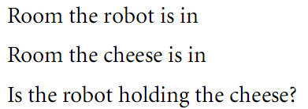
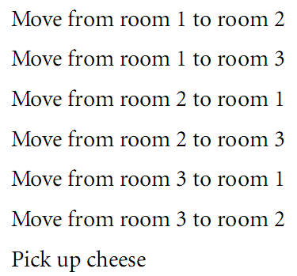
Planning as Search
A robotic planning agent might have a state that is described by the following variables:
Let, there are three rooms, room1, room2 and room3
There is a door from each room to each other
The robot starts from room1 and cheese at room3
The robot’s goal is to find the cheese
The actions the robot can take
‹#›

Slide 4
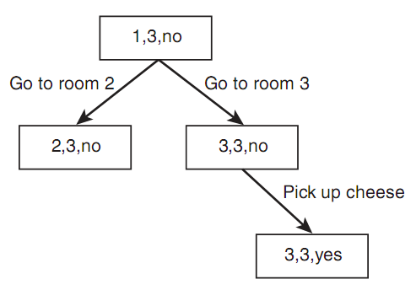
Planning as Search
Use a three-value vector to present current state
(room robot is in, room cheese is in, is robot holding cheese?)
(1, 3, no) is the initial state
(3, 3, yes) is the goal state
The actions the robot can take
‹#›

Slide 5
Planning as Search
In real world problems, many more states, and many actions
The search tree even for a simple problem is prohibitively large
Search always is not from the start state, it may start from goal state
Search is not feasible for multiple independent goals
Buy some eggs, feed the cat, and get little Johnny a haircut
Each of the three goals can be solved separately not consecutively
Some cases order of the goal is important
Feed the cat, and wash the cat’s bowl
Put food into cat’s bowl and then wash it immediately without waiting for the cat to eat
8 puzzle problem, if you move a tile to a square other tiles will also move, i.e. Situation changes
‹#›

Slide 6

Situation Calculus (1)
An extension of FOPC (First Order Predicate Calculus).
For example:
S₁ is a situation variable.
The above statement tells us that in situation S₁ the robot is in the same room as the cheese.
This notation, unlike FOPC, allows us to describe things that change over time.
‹#›

Slide 7


Situation Calculus (2)
Not all object change over time. We can use standard predicates without a situation variable.
The Result function allows us to describe the result of carrying out actions:
This states that if in situation S₁the planner carried out the action Move_{1,2} it will be in situation S₂
An effect axiom describes the effect of carrying out an action. For example:
‹#›
Notes:
If the robot is in a room, y, and an object x is also in that room, then if the robot carries out a Take action, this will result in a new situation in which the robot has object x.
‹#›

Slide 8
The Frame Problem (1)
An effect axiom does not specify what does not change when an action is taken.
Determining what stays the same is the frame problem.
This can be difficult – usually there are very many things that do not change when an action is taken.
Frame axioms specify things that do not change. For example:
∀ y, s In (Robot, y, s) → In (Robot, y, Result (Take, s))
This states that if the robot is in room y and it takes an object then it will still be in room y.
‹#›

Slide 9
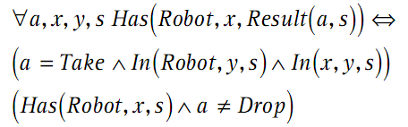
The Frame Problem (2)
Even in a simple problem, a planner can need an enormous number of frame axioms.
This is the representational frame problem.
One way to solve this problem is to combine frame axioms and effect axioms into successor state axioms such as:
‹#›

Slide 10
Means-Ends Analysis
Means-ends analysis involves examining the differences between the current state and the goal state.
Actions are selected that minimize these differences.
The planner can select an action even if it is not currently possible. It must then select another action that will make the first action possible.
‹#›

Slide 11


The Blocks World
Many planning systems can be illustrated using the blocks world.
The blocks world consists of a number of blocks and a table.
The blocks can be picked up and moved around.
The following shows the start and goal states of a simple problem:
‹#›
Start state
Goal state

Slide 12


The Blocks World
Using means-ends analysis, planner considers the difference
Planner now considers the following two possible actions
‹#›
Start state
Goal state

Slide 13

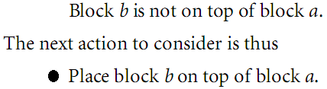
The Blocks World
Planner now considers the following two possible actions
Planner might start with action 2 and the goal state are now
Planner’s next action might be to place block a on the table
‹#›
Start state

Slide 14


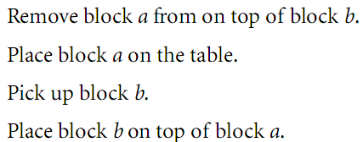
The Blocks World
However, the robot is not holding block b, so we have the following new goal state
So, carry out the following action
Thus the sequence of actions can be
‹#›
Start state

Slide 15
Planning Methods: STRIPS
Stanford Research Institute Problem Solver (STRIPS)

Slide 16
STRIPS (1)
Stanford Research Institute Problem Solver.
An operator based planning system that uses means-ends analysis.
STRIPS uses wffs in FOPC to describe the world.
For example:
States that if an object is in one location then it cannot be in another. Here, x and y are physical coordinates i.e. x = (1,1) etc.
STRIPS was designed to enable a planner to devise plans for a robot which is to solve problems in the blocks world.
‹#›

Slide 17
Planning and Executing
Let, operator Push (o, x, y) enables the robot to push object o from location x to location y
There is difference between operator Push and actually carrying out of the act of pushing
Pushing might need to go the robot to location x, take the object o, move to location y, put o at y.
This is the difference between planning and executing
So, a plan can be a sequence of operators
If carrying out a action of an operator has unexpected result, then plan may not succeed. Robot might need to change plan or so.
‹#›

Slide 18
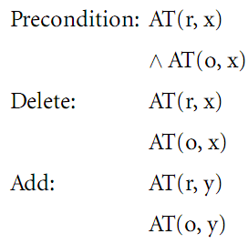
Operators
STRIPS defines operators as in the following operator schema for operator Push(o, x, y):
The preconditions specify what must be true for the operator to be applied.
The delete and add lists specify the changes that will take place after the operator is applied.
‹#›

Slide 19

Operators
A real action is an instance of the schema, in which variables are instantiated with actual object
Let push object o₁ from position (2,3) to position (1,4)
If the world model can instantiate the preconditions of a particular operator, then we say the operator is applicable.
The goal state is also described by a set of wffs. If the planner can reach this goal state, it has successfully solved the problem and is ready to execute the plan.

Slide 20
STRIPS Implementation
STRIPS uses resolution and means-ends analysis to devise plans:
The goal is negated, and the rule schemata are instantiated with objects from the real world.
If the resolution fails, then the goal has been achieved.
Otherwise, a plan must be devised.
‹#›

Slide 21
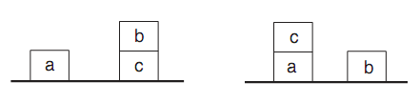
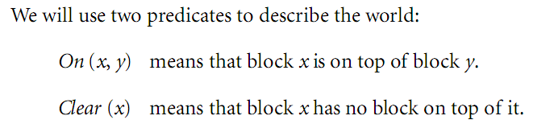
STRIPS Example
Start state
Goal state
Also, let
So, the goal is:
‹#›

Slide 22
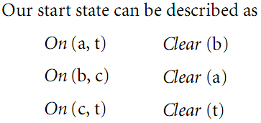
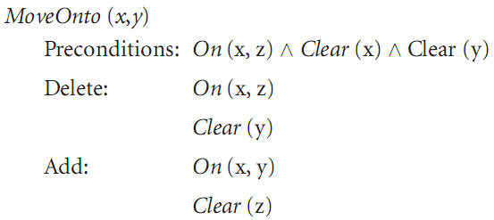
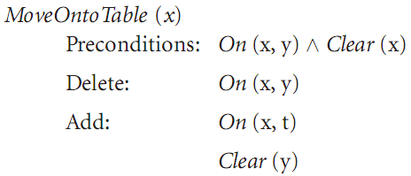
STRIPS Example
Start state
Goal state
We also have two operators described as the following schema
‹#›

Slide 23
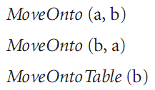
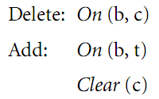


STRIPS Example Forward Chaining
Search through the whole space until goal found
From initial state, three operators we could apply
Start state
Goal state
Suppose we choose to apply
that has precondition
‹#›

Slide 24

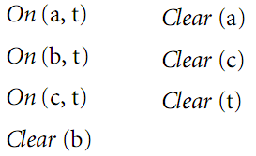
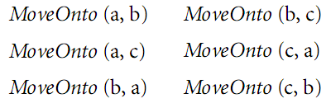
STRIPS Example Forward Chaining
Start state
Goal state
Hence, state description becomes
From this position, we can apply any of the following operators:
‹#›
Did not use means-end analysis

Slide 25
STRIPS Example Means-ends analysis
Start state
Goal state
Start noticing the difference between star and goal state
To reduce the difference apply MoveOnto (c,a), no matter that c is movable of not
Operator MoveOntoTable (b) has the desired effect of clearing c.
So using backward chaining, identify steps that could lead to the goal.
MoveOnto (b,a), also clears c, but makes the problem harder, resulting in backtracking.
‹#›

Slide 26
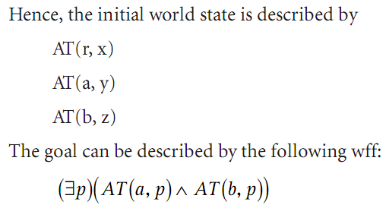
STRIPS Example Resolution
Let take a different example
A robot start at position x, take two objects a and b together, where a in position y and b in position z
Assumptions
Two objects are together when they are both at the same position
Robot can push two objects together
‹#›
Notes:
‹#›

Slide 27
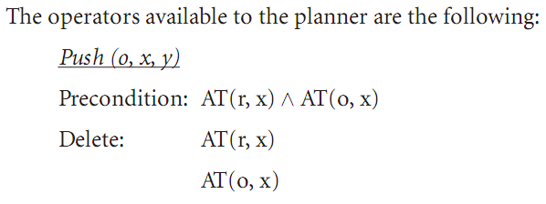

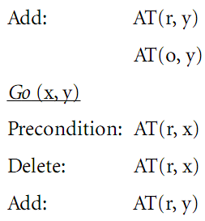


STRIPS Example Resolution
‹#›

Slide 28
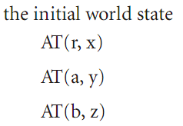
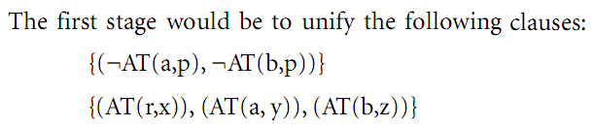


STRIPS Example Resolution
Rectify the difference
b is not at location y, but in location z
STRIPS will try to apply operator Push (b, z, y)
‹#›

Slide 29
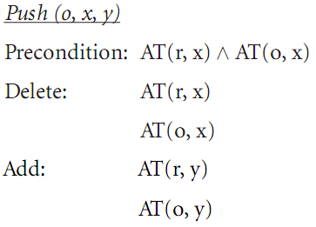



STRIPS Example Resolution
Rectify the difference
b is not at location y, but in location z
STRIPS will try to apply operator Push (b, z, y)
Try to meet preconditions of Push operator
‹#›

Slide 30

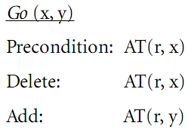

STRIPS Example Resolution
Rectify the difference
r is at location x, but in needs to go at location z
Then operator Push (b, z, y) will be successful
Hence the Go (x, z) operator is attempted
Process continues and a set of operators are found
‹#›

Slide 31
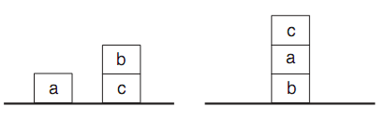
The Sussman Anomaly
Start sate
Goal sate
STRIPS approach would start by either
Moving b onto the table, then placing c on a
Or moving a on top of b without removing b from c
In either cases, undo the first move

Slide 32

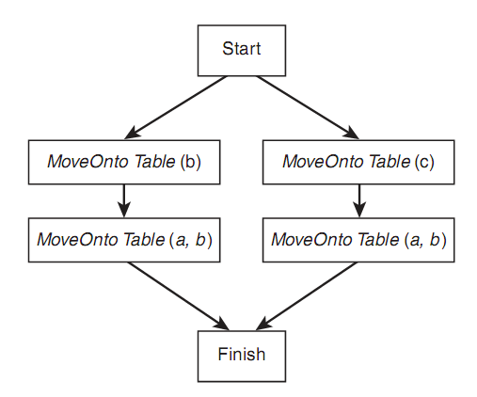
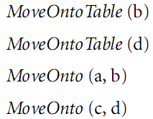
Partial Order Planning (1)
A total order plan specifies the order in which all actions must be carried out.
A partial order plan can specify some actions in parallel – these actions can be carried out in any order relative to each other.
Start state
Goal state
‹#›
Total order plan
Partial order plan

Slide 33
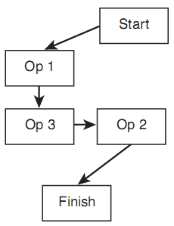
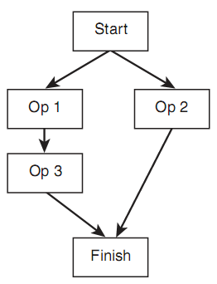
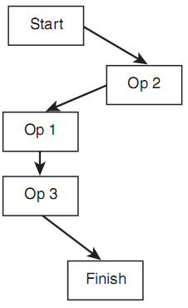
Problems in Partial Order Planning
One action might undo the effects of another action, in which case order of actions is important.
Demote
Promote
Let, x is in precondition list of Op3, and x is in add list of Op1
Unfortunately x is in delete list of Op2
If after Op1, Op2 is executed, Op3 can not be executed.
‹#›
Notes:
Figure 1 might have problem so promote it or demote it
‹#›

Slide 34
The Principle of Least Commitment
In building a plan there will be some variables and objects that can be ignored, as they are superfluous to the goal of the plan.
For example, there is a block e on the table that might be used in forward chaining.
However, it does not need to be instantiated
This is the Principle of Least Commitment.
Start state
Goal state
‹#›

Slide 35
Planning Methods: Planning Graphs

Slide 36
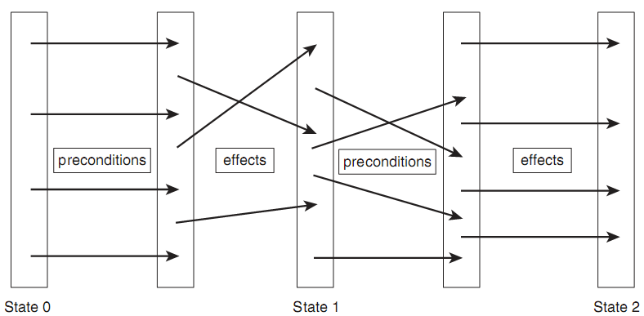
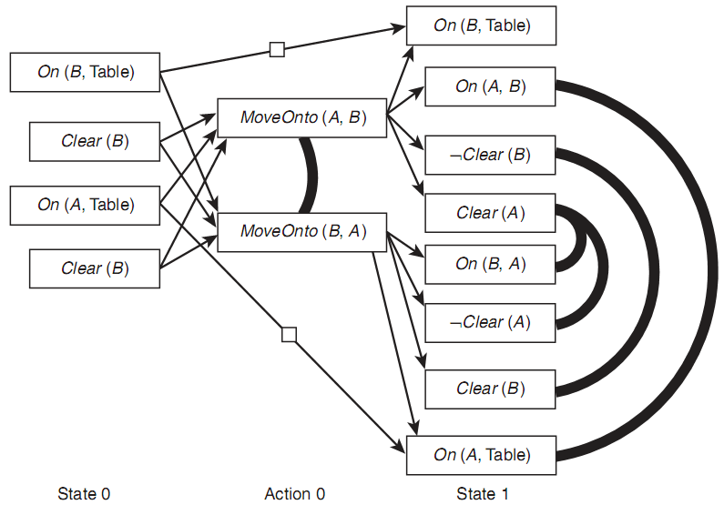

Planning Graphs
Even-numbered levels represent states. Odds are actions.
All possible actions are shown in the graph.
Initial state
Goal state
‹#›

Slide 37
Planning Graphs
Persistence actions: Propositions that do not change as a result of a given action.
Shown as an arrow with a clear box on it.
Mutual Exclusoin or Mutexes: Actions that are mutually exclusive
Shown as heavy black lines
Initial state
Goal state
‹#›

Slide 38
Mutex Conditions
Actions that have inconsistent effects.
MoveOnto (A, B) and MoveOntoTable(A) are mutex, because one has the effect of adding On (A, B) and the other adds On (A, Table)
Effect of one action interferes with the precondition of another.
MoveOnto(A, B) deletes Clear (B), while MvoeOnto(B, A) has the precondition Clear (B)
One action has P as precondition, and the other has as precondition ¬P
Initial state
Goal state
‹#›

Slide 39
Planning Graphs
The planning graph for even a simple problem can be extremely complex.
By producing a complete planning graph for a problem, it can be determined whether a plan is possible, and the plan itself can also be derived.
Algorithms such as GraphPlan can be used to extract the plan.
‹#›
Notes:
‹#›

Slide 40
GraphPlan
Problems are expressed in STRIPS notation.
GraphPlan iteratively builds a planning graph, starting from the initial state and working towards the goal state.
All applicable operators are applied at each level to produce the next level .
When the propositions necessary for the goal are included in the current level, and they are not mutex, a possible solution may have been reached.
A plan is found by backtracking from final level and including operators that are not mutex and that provide all of the conditions required at each level.
The GraphPlan produces a partial order plan.
‹#›

Slide 41
References
Chapter 15, 16 of “AI Illuminated” by Ben Coppin.

